Slide 1
Optimization for Neural Networks

Slide 2
Gradient Descent
Gradient descent is an algorithm to minimize the loss function w.r.t parameters.
Types of Gradient Descent
Batch Gradient Descent
Stochastic Gradient Descent
Mini Batch Gradient Descent

Slide 3

Gradient Descent
Batch Gradient Descent

Slide 4

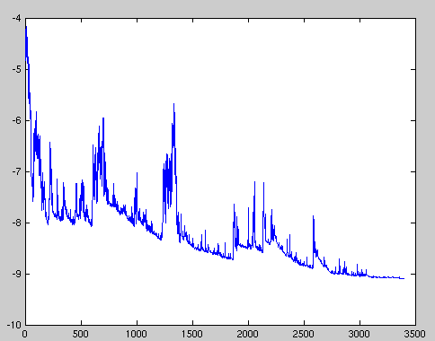
Gradient Descent
Stochastic Gradient Descent

Slide 5

Gradient Descent
Mini Batch Gradient Descent
Cons:
Need to tune the learning rate carefully.
Use same learning rate to update all parameters.
Less frequent feature parameter should receive the larger update
Compare to the most frequent feature parameter

Slide 6
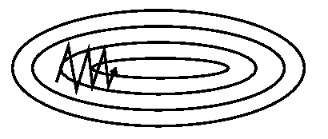
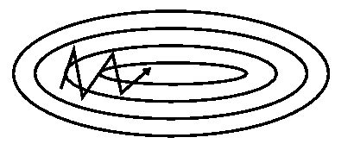
Momentum
SGD without Momentum
SGD with Momentum

Slide 7

Momentum
SGD without Momentum
SGD with Momentum
Cons: Oscillate around the minimum point

Slide 8


Nesterov accelerated gradient
$$γ is moment decay rate$$

Slide 9
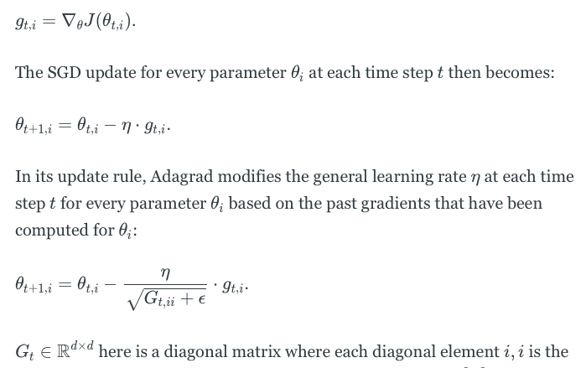
Adagrad

Slide 10





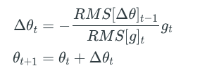


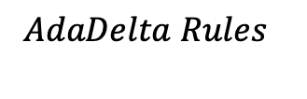

Adadelta
$$SGD Rules$$
$$Adagrad Rule$$
$$where$$
$$AdaDelta Rules$$

Slide 11
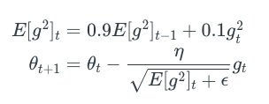
RMSprop

Slide 12

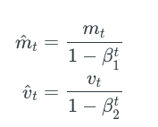
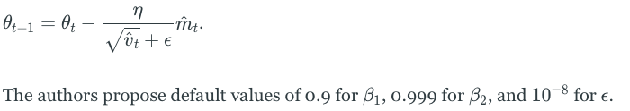





Adam
$$1st Order moment$$
$$1st Order moment$$
$$1st Order moment bias correction$$
$$2nd Order moment bias correction$$
$$Parameter updation Rule$$
$$β_{1}=First Order Moment Decay rate,β_{2}=Second Order Moment Decay rate$$

Slide 13
SGD optimization on loss surface contours
SGD optimization on saddle point

Slide 14
Reference
https://ruder.io/optimizing-gradient-descent/

